Slide 1
Diseases Detection And Prediction of Retinopathy Using Machine Learning
Mentor :
Presented By :
Daranee Singh
Deepak Gupta
Mr Amit Kumar Singh
Mohd Faiz
Cetpa Infotect Pvt.Ltd

Slide 2
Table of Content
01
Problem Statement
07
System Specifications
02
Introduction
Hardware requirement
Software requirement
User Characteristics
Assumption
03
Proposed System
04
Objective or need of identification
08
Modules Description
05
Initial Requirement And
Feasibility Study
09
Logical and Physical Design
Use case Diagram
Class Diagram
Activity Diagram
Feasibility Study
Functional
Non Functional
10
Algorithms
06
System Analysis
11
Screen shots
Methodology Used
User And Rules
Gantt Chart
12
Future Scope
13
Conclusion

Slide 3
Problem Statement
The core idea behind the project is to propose a system that allows users to get instant guidance on their health issues.
This system allows user to share their symptoms and issues .
It processes user’s symptoms to check for various illnesses that could be associated with it.

Slide 4
Welcome!!
“Self care is the best Health Care !”
Introduction
Disease Predictor is a application that predicts the disease of the user with respect to the symptoms given by the user. This system has data set collected from different health related data source .
With the help of Disease Predictor the user will be able to know the probability of the disease with the given Symptoms.
Retinopathy is a potentially blinding disease caused by abnormal development of retinal blood vessels in premature infants. The retina is the inner layer of the eye that receives light and turns it into visual messages that are sent to the brain.

Slide 5
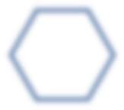
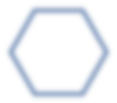
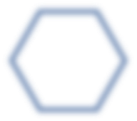
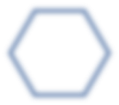
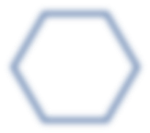
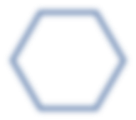

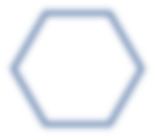
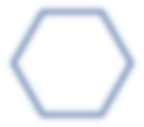
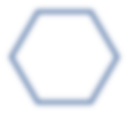
SYSTEM ANALYSIS
Need of Identification
The main purpose behind this project is to help people to get quick guidance related to their health issue. Sometimes we need a doctor right away or don't feel well and want to know the reason behind the illness, so to overcome this type of problems we've used a technique that only From the given symptoms one can estimate the probability of illness. This application has used machine learning algorithms based entirely on mathematical formulas that help make it easier to predict probability.

Slide 6
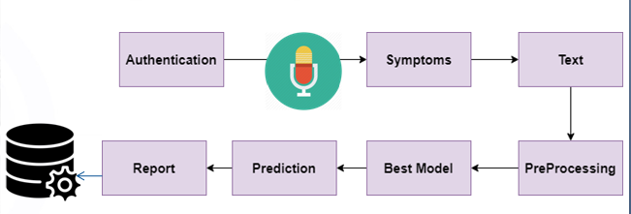
Proposed System
The system is designed to use intelligent data mining techniques to guess the most accurate illness based on patient’s symptoms. If user’s symptoms do not exactly match any disease in the database, then it is shows the diseases user could probably have based on his/her symptoms.

Slide 7
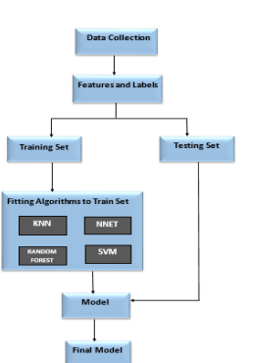
Proposed system of retinopathy

Slide 8
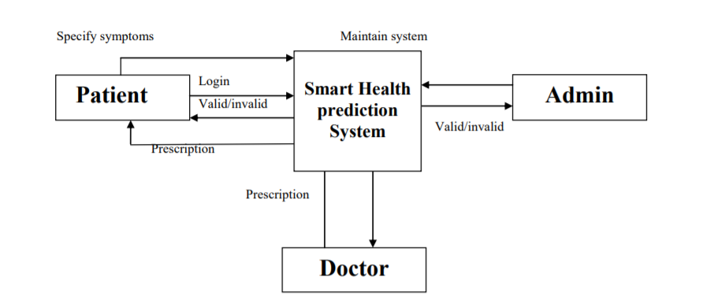
Architecture
Fig : Architecture Of Disease Prediction

Slide 9
Objective
General objective:- To implement Naïve Bayes Classifier that classifies the disease as per the input of the user.
Specific Objective:- To develop user interactive platform for the prediction of disease

Slide 10
Initial Requirement And Feasibility Study
Feasibility Study
Technical Feasibility:-The project is technically feasible as it
can be built using the existing available technologies.
2. Economic Feasibility:- The project is economically feasible as the data samples increases, which consume more time and processing power. In that case better processor .
3. Operation Feasibility:- The project is operationally feasible as the user having basic knowledge about computer and Internet. Disease Predictor is based on client-server architecture where client is users and server is the machine where datasets are stored.

Slide 11
Requirement Analysis
Functional Requirement:-
a. Predict disease with the given symptoms.
b. Compare the given symptoms with the input datasets
2. Non functional Requirement:-
a. Display the list of symptos where user can select the symptoms.
b. Naïve Bayes Classifier is used to classify the data sets.

Slide 12
Methodology Used
Data collection and dataset preparation
Developing a probabilistic modeling And
deep learning
Training and experimentation on Datasets
Deployment and analysis on real life
Scenario

Slide 13
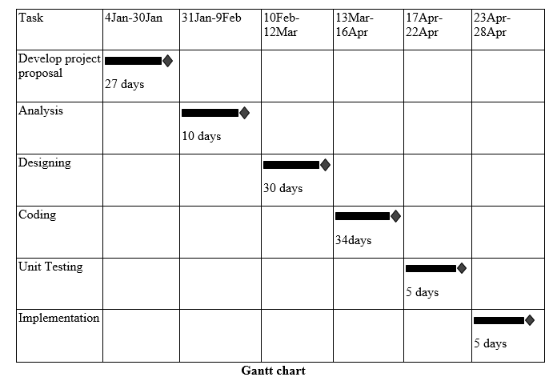
Gantt Chart

Slide 14
System Requirement
Hardware Specification
System : Dual Core Processor or above
Hard Disk : 500 GB.
Monitor : 15’’LED
Input Devices : Keyboard, Mouse
Ram : 4GB.

Slide 15
Software
Specification
Operating system : Windows 7/UBUNTU.
Coding Language : Python 3.7
IDE : Anaconda(Jupyter)
Database : Sqlite3 Manager
Other: Db Browser
.

Slide 16
Module Description
Patient Registration: Patient can register to the system by given his personal details.
Patient Login: Patient can login to the system using his ID and Password.
Patient Details: Admin can view patient’s personal details.
Admin Registration: Admin can register to the system by given his personal details.
Admin Login: Admin can login to the system using his ID and Password.
Disease type: It shows different types of disease.
Add Disease: Admin can add disease details along with symptoms and type.
View Disease: Admin can view various diseases details stored in database.
View Patient: Admin can view various patient details that had accessed the system.
General disease: It shows general disease along with symptoms.
Other disease: : It shows other disease along with symptoms which have not added in dataset

Slide 17
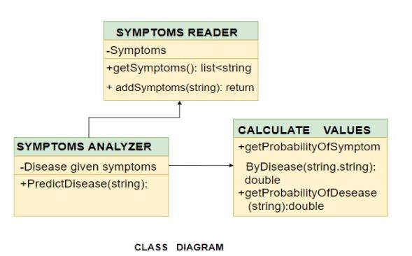
Logical Diagram
Class Diagram
Symptoms Reader: Reads the user input and creates the list of symptoms.
Symptoms Analyzer: According to symptoms parameter displays the subjective result.
Calculate Values: Calculates the probabilistic model of the diseases.

Slide 18
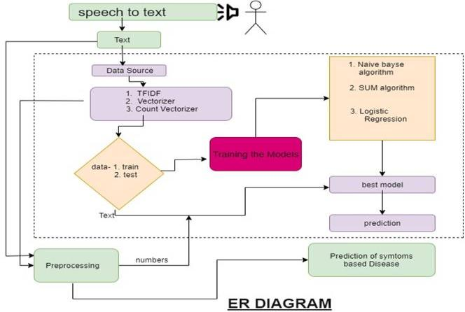
Activity Diagram

Slide 19
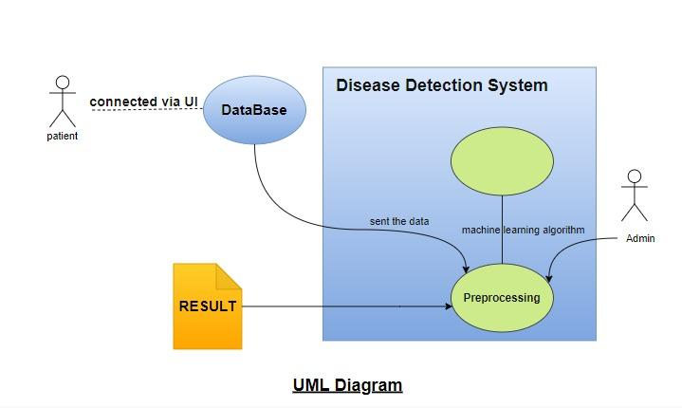
Use Case Diagram

Slide 20
Algorithms
Random Forest:- Random forest algorithm can use both for classification and the regression kind of problems. It is supervised classification algorithm which creates the forest with a number of tress . There are many advantages of random forest algorithms. The classifier can handle the missing values. It can also model the random forest classifier for categorical values .we use algorithms to get probabilistic accuracy of he disease.
Decision tree:- In general, decision trees are constructed via an algorithmic approach that identifies ways to split a data set based on different conditions. The goal is to create a model that predicts the value of a target variable by learning simple decision rules inferred from the data features.
Naïve bayes :- It is a classification technique based on Bayes' Theorem with an assumption of independence among predictors. In simple terms, a Naive Bayes classifier assumes that the presence of a particular feature in a class is unrelated to the presence of any other feature. it helps to predict future probabilistic accuracy and this algorithm is mostly used for future prediction.

Slide 21
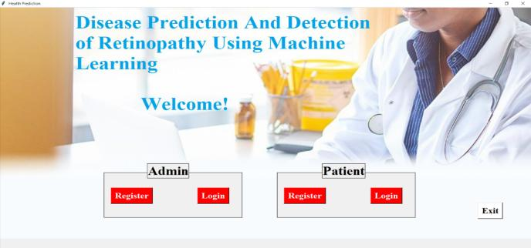
Screenshots
Home page:-

Slide 22
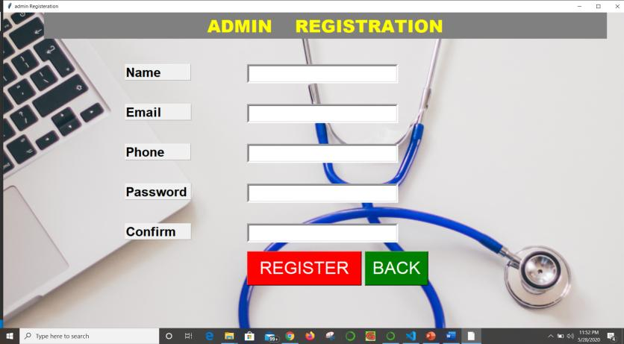
Admin Registration Page :-

Slide 23
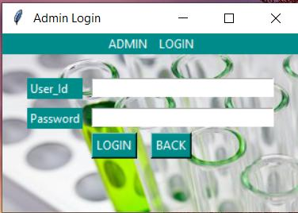
Admin Login Page :-

Slide 24
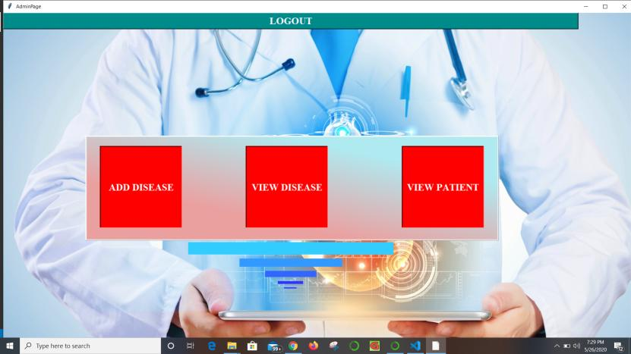
Admin Homepage :-

Slide 25
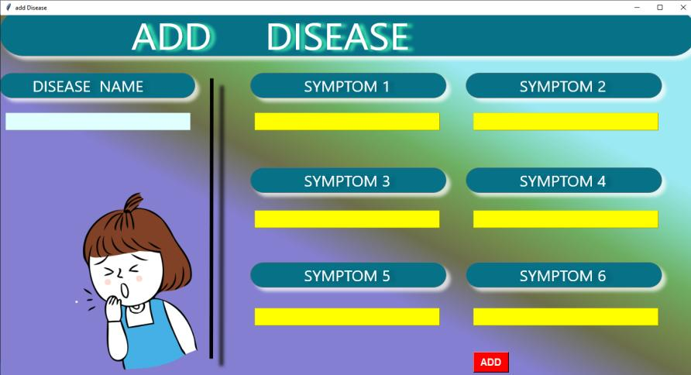
Add Disease Page:-

Slide 26
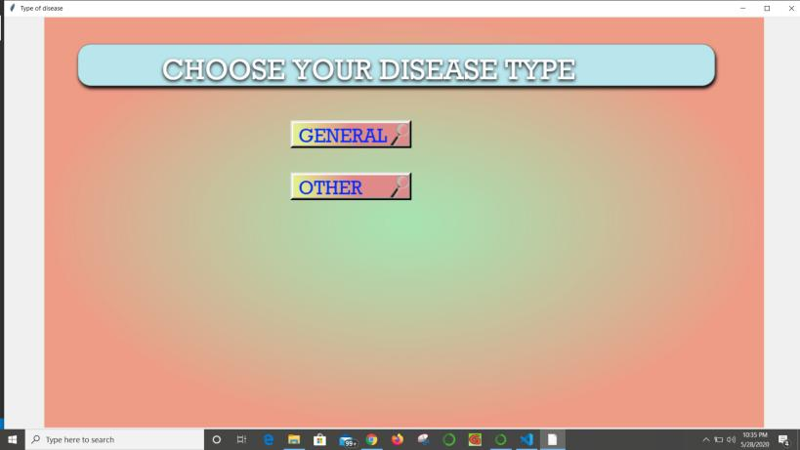
View Disease Page:-

Slide 27
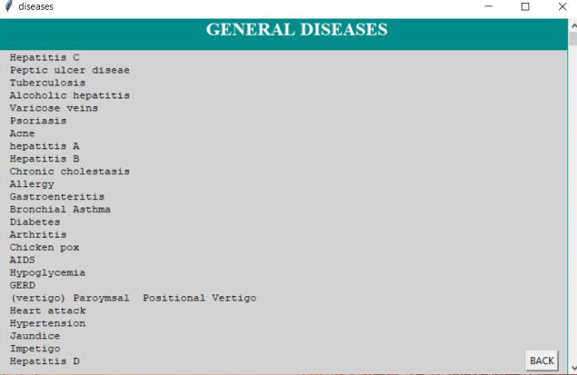
General Disease Page:-

Slide 28
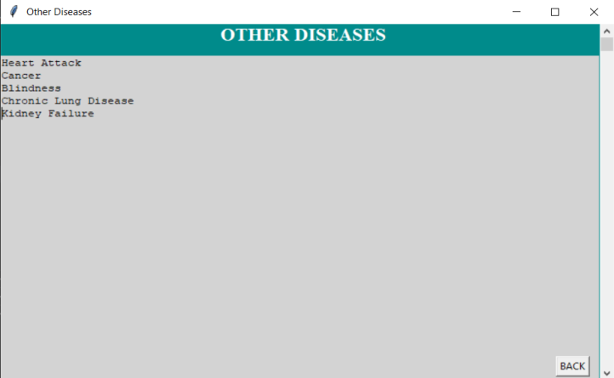
Other Disease Page:-

Slide 29
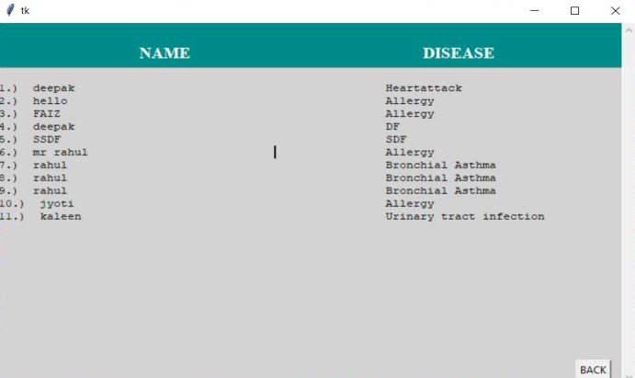
View Patient Page:-

Slide 30
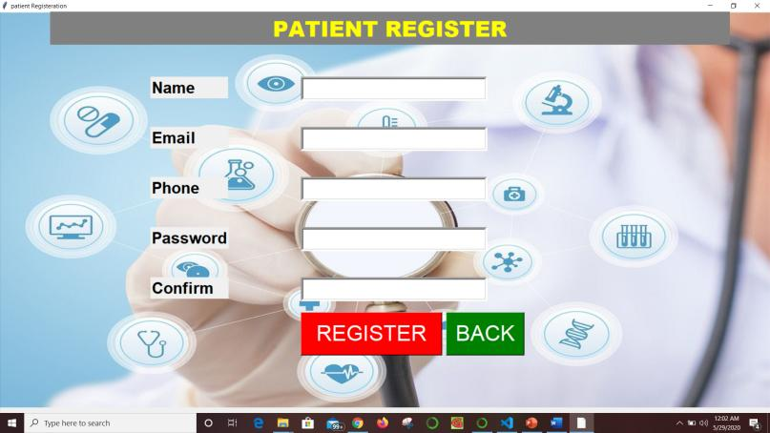
Patient Registration Page:-

Slide 31
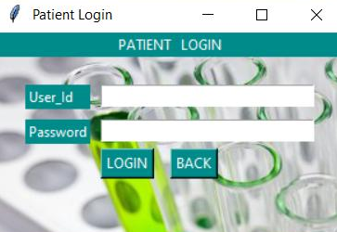
Patient Login Page:-

Slide 32
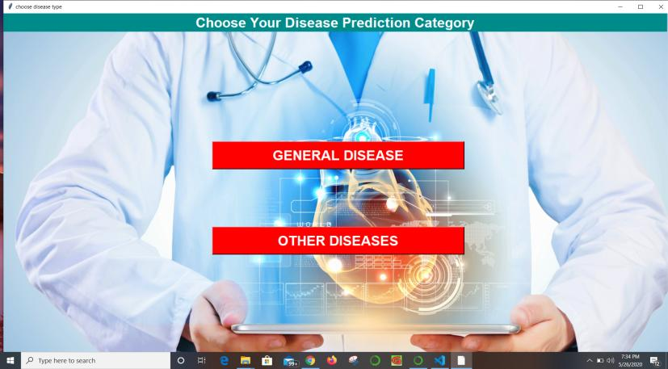
Patient Homepage:-

Slide 33
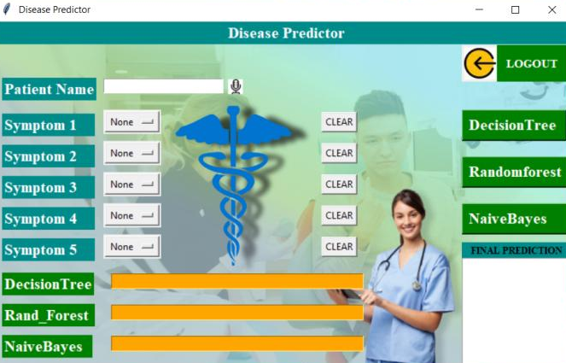
General Disease Prediction Page:-

Slide 34
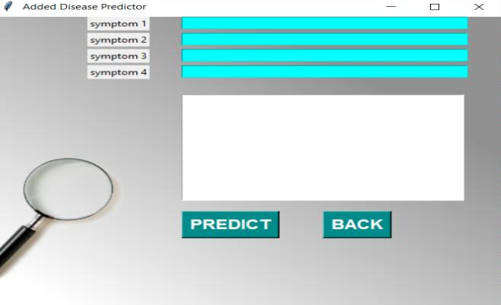
Other Disease Prediction Page:-

Slide 35
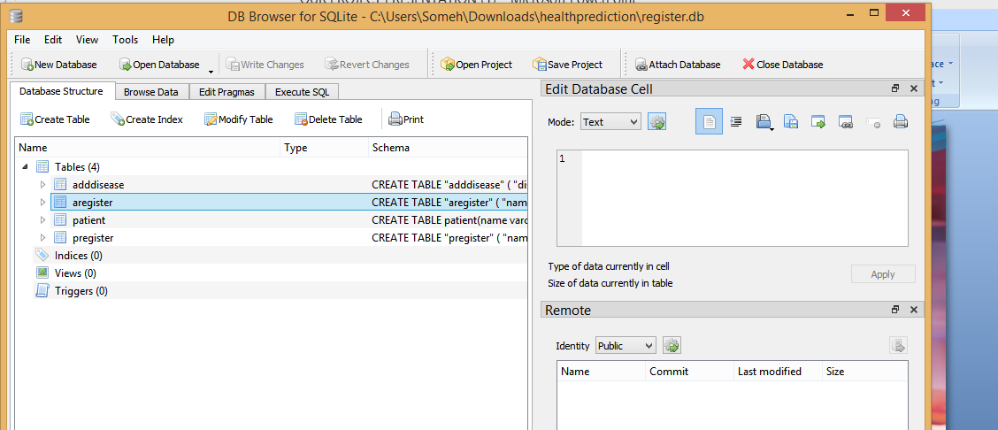
DB browser (DataBase):-

Slide 36
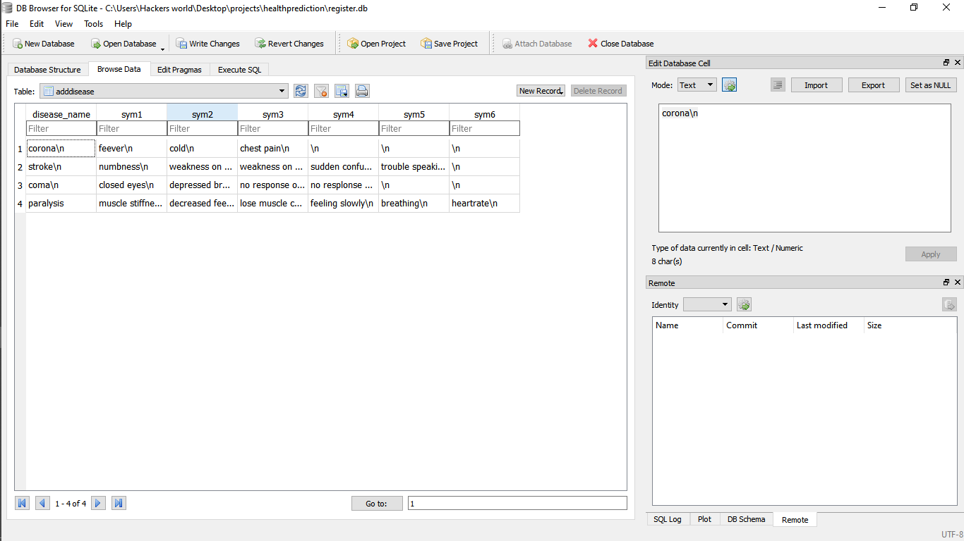
ADDING DISEASE

Slide 37
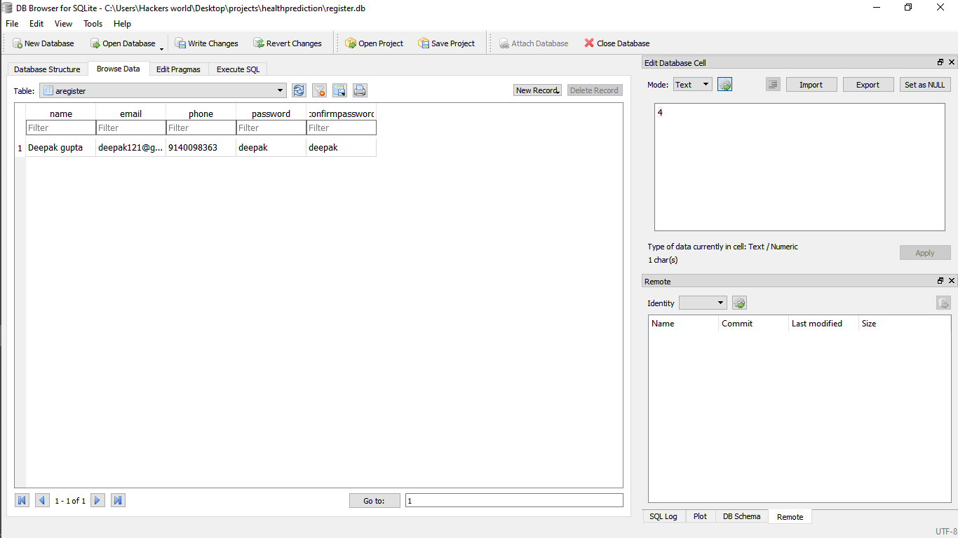
ADMIN REGISTERATION

Slide 38
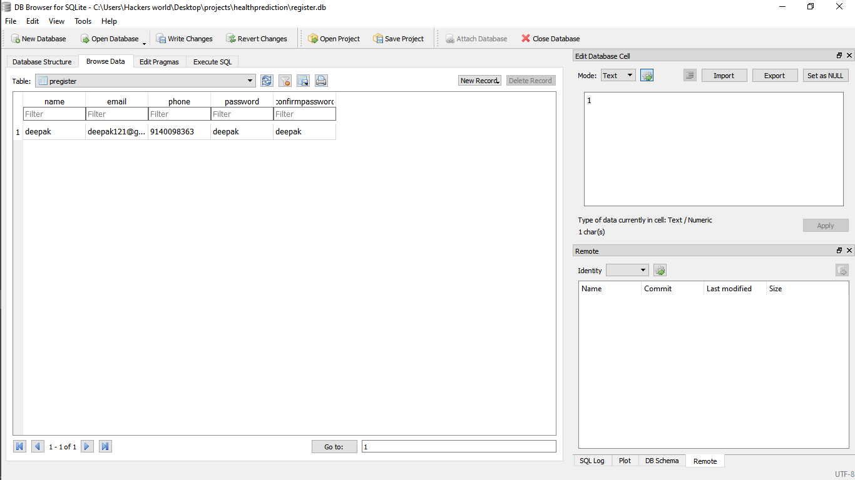
PATIENT REGISTERATION

Slide 39
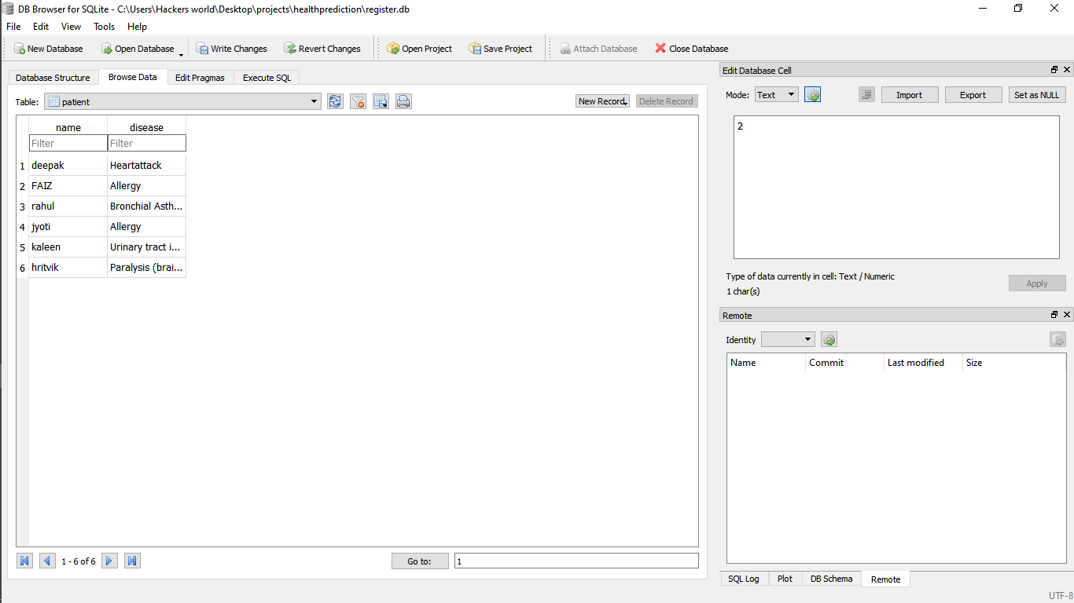
PATIENT

Slide 40
Future Scope
By using machine learning we can implement this application in more relevant way as it can predict the symptoms with the help of mathematical model and these model give more probabilistic accuracy related to dataset. Machine learning algorithms works based on dataset which helps to predict more accurate result than using another approach that’s why we use machine learning. We can implement this project into android so that people can use it as mobile application.

Slide 41
CONCLUSION
This project aims to predict the disease on the basis of the symptoms. The project is designed in such a way that the system takes symptoms from the user as input and produces output i.e. predict disease. Average prediction accuracy probability of 55% is obtained. Disease Predictor was successfully implemented using grails framework and machine learning algorithms. it helps people to get quick guidance which consume less time .

Slide 42
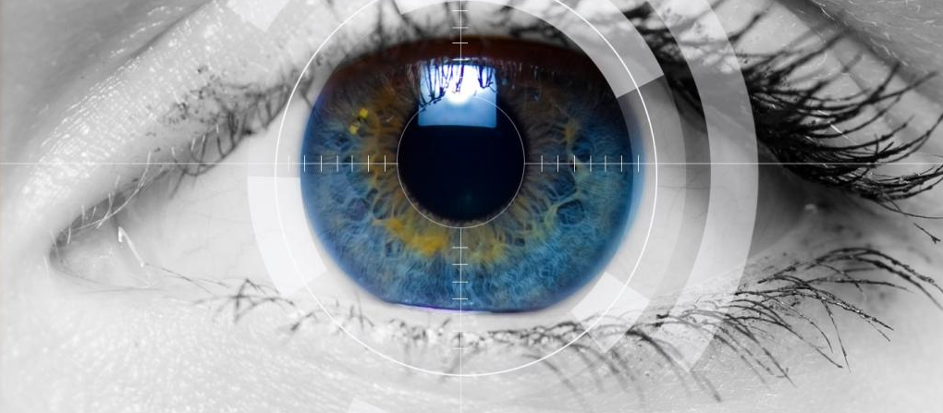
THANK YOU

